Slide 1



THE MANHATTAN PROJECT
01
02
Exploratory Data Analysis on
03
Spotify Tracks
~ By Rohan kumar

Slide 2


Problem Statement
To perform a comprehensive analysis to understand the characteristics of the tracks, identify key relationships between different audio features, and uncover insights that could be used for tasks like music recommendation or understanding music trends.
01
02
03

Slide 3



Objectives
Initial Data Inspection
Handling Missing Values
Distribution Analysis
Relationship Analysis
Categorical Feature Analysis
Trend Analysis
Uncovering Insights
01
02
03

Slide 4
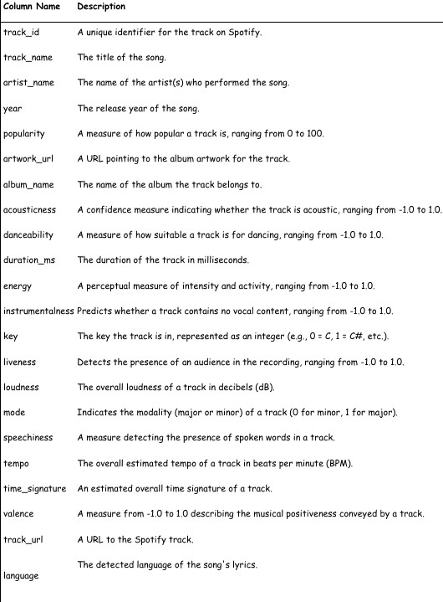
01
Data Description
02
03

Slide 5




Workflow
Univariate Analysis
Item 3
12.5%
Bivariate Analysis
Multivariate Analysis
20
Item 1
Item 2
Item 3
Item 4
140
Series 1
Series 2
Series 3
01
120
15
100
80
Item 2
25%
10
02
60
Item 1
62.5%
5
40
0
20
Item 1
Item 2
Item 3
Item 4
0
Item 1
Item 2
Item 3
Item 4
Item 5
03
Outlier Analysis
Series 1 Series 2
Time Series Analysis
40
Item 1
30
Item 2
20
10
Item 3
0
5
10
15
20
0
Item 1
Item 2
Item 3
Item 4
Item 5

Slide 6





Univariate Analysis
01
02
03
ore

Slide 7
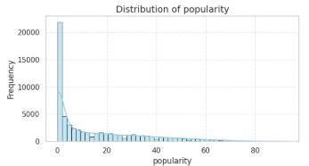
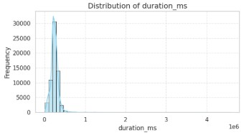
Distribution of Popularity Scores
Average and typical song duration
About
01
02
Song durations are right-skewed, with most songs between 2–5 minutes and a few extremely long tracks creating a long tail.
03
Popularity shows a slightly right-skewed distribution, with most songs clustered around low to moderate popularity values and fewer songs reaching very high popularity scores.

Slide 8
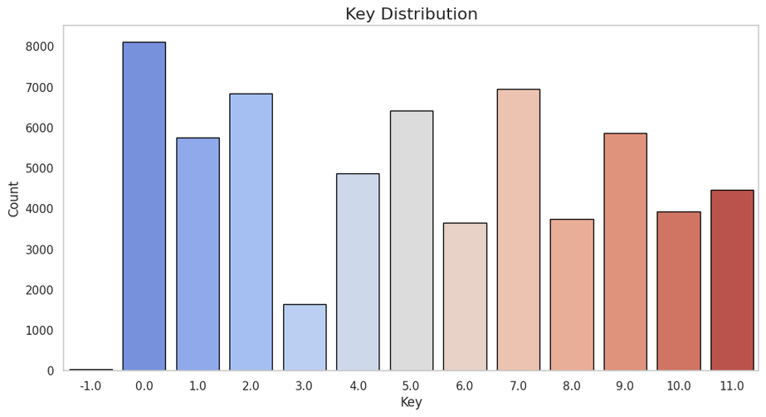
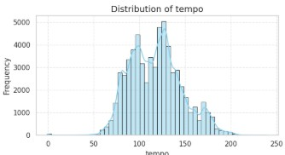
Most Frequent Keys
About
Distribution of Tempo
01
02
03
Most songs are concentrated in certain keys, such as C, G, and D, which are the most common in Western music. Less frequently used keys appear as lower bars, showing that some keys are rarely chosen by artists.
Tempo shows a moderately normal distribution, but with small peaks at common tempo values reflecting popular beats per minute.

Slide 9
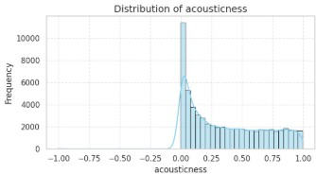
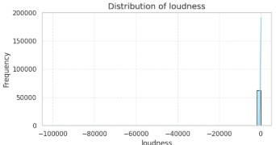
Distribution of Acousticness
About
Typical Loudness Levels (dB)
01
02
03
Acousticness displays a bimodal pattern, with prominent peaks near 0 and 1. This suggests that the dataset includes a mix of highly acoustic and minimally acoustic tracks, reflecting both traditional and electronically produced music.
Loudness distribution is approximately normal, but with slight skew due to extremely quiet or extremely loud tracks.

Slide 10
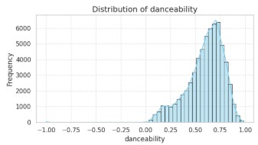
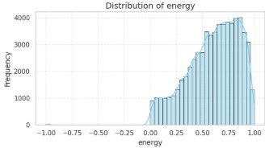
Distribution of Danceability
About
Distribution of Energy Levels
01
02
03
Danceability exhibits a slight left skew, with a concentration of songs in the moderate to high range.
This indicates that the dataset primarily consists of rhythmically engaging, dance-oriented tracks.
Energy exhibits a slightly left-skewed distribution, suggesting many songs have moderate to high energy levels.

Slide 11
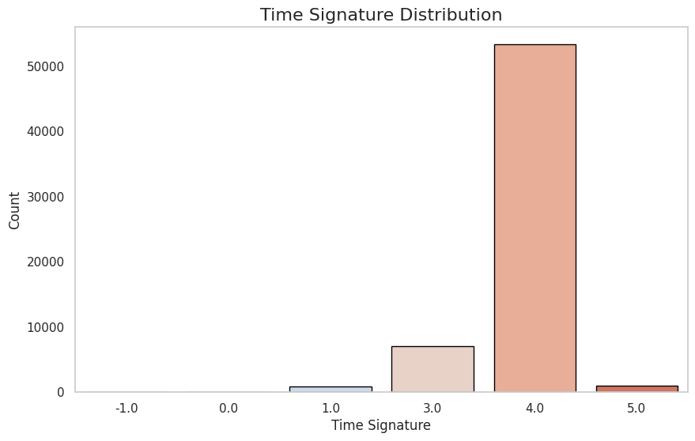
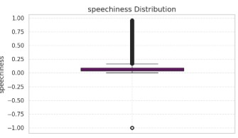
Most Common Time Signatures
About
Distribution of Speechiness
01
02
03
Most songs use the standard 4/4 time signature, which is the dominant rhythm in modern music. Other time signatures like 3/4 or 6/8 occur rarely, appearing as shorter bars in the plot, indicating their less frequent use in popular tracks.
Speechiness is highly right-skewed.
Most songs have low speech content, with rap or spoken-word tracks as high-value outliers.

Slide 12
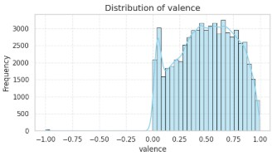
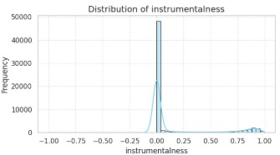
Distribution of Valence (Musical Positivity)
About
Distribution of Instrumentalness
01
02
03
Valence is slightly bimodal, with peaks near low and high values, indicating songs tend to be either very sad/negative or very happy/positive in mood.
Instrumentalness is highly right-skewed, as most tracks have low instrumentalness, but a small number are fully instrumental, creating a long tail.

Slide 13
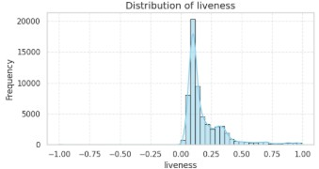
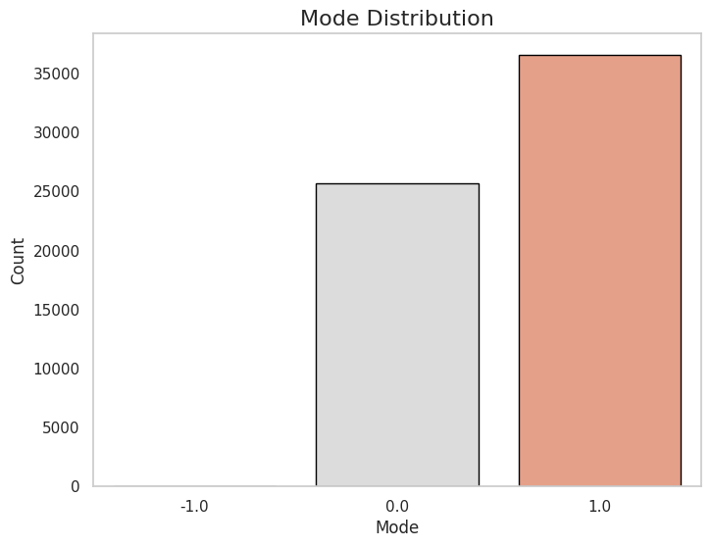
Distribution of Liveness
About
Common Values for Mode (Major/Minor)
01
02
03
Liveness is right-skewed, with most songs having low liveness scores, indicating studio recordings, and a few songs with high liveness representing live recordings.
The majority of songs are in major mode, with a smaller proportion in minor mode. This reflects the general preference for brighter, major-key tracks in popular music.

Slide 14


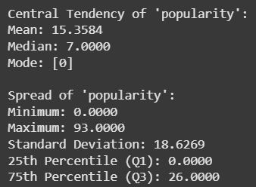
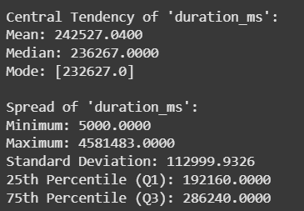
Median & Quartiles for Popularity and Duration
Popularity
Duration
01
02
03

Slide 15
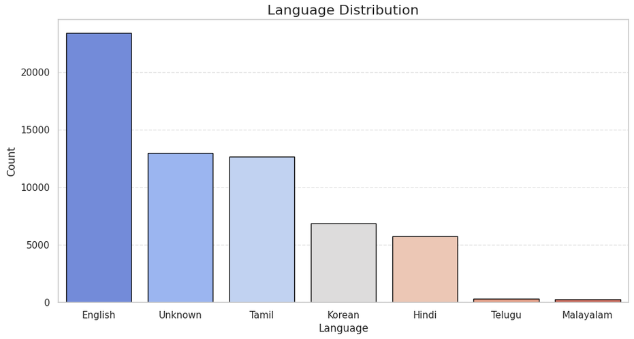
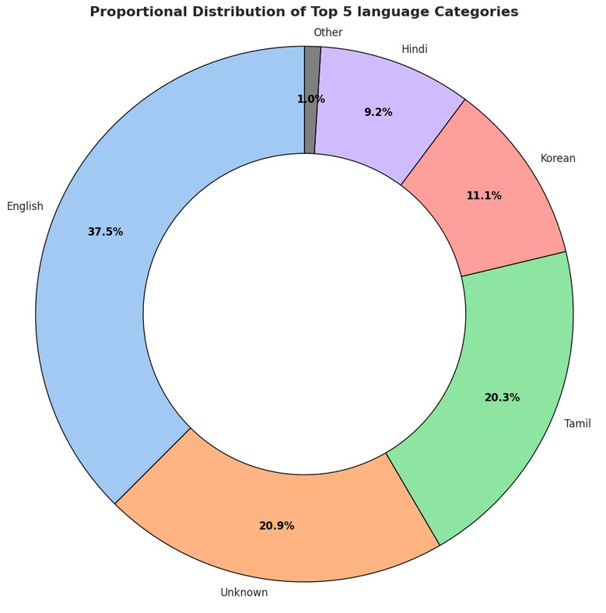
Distribution Across Language Categories
01
02
03
The dataset is dominated by English songs, followed by Unknown and Tamil tracks. Korean and Hindi are moderately represented, while Telugu and Malayalam have very few songs, indicating a strong bias toward English music in the dataset

Slide 16

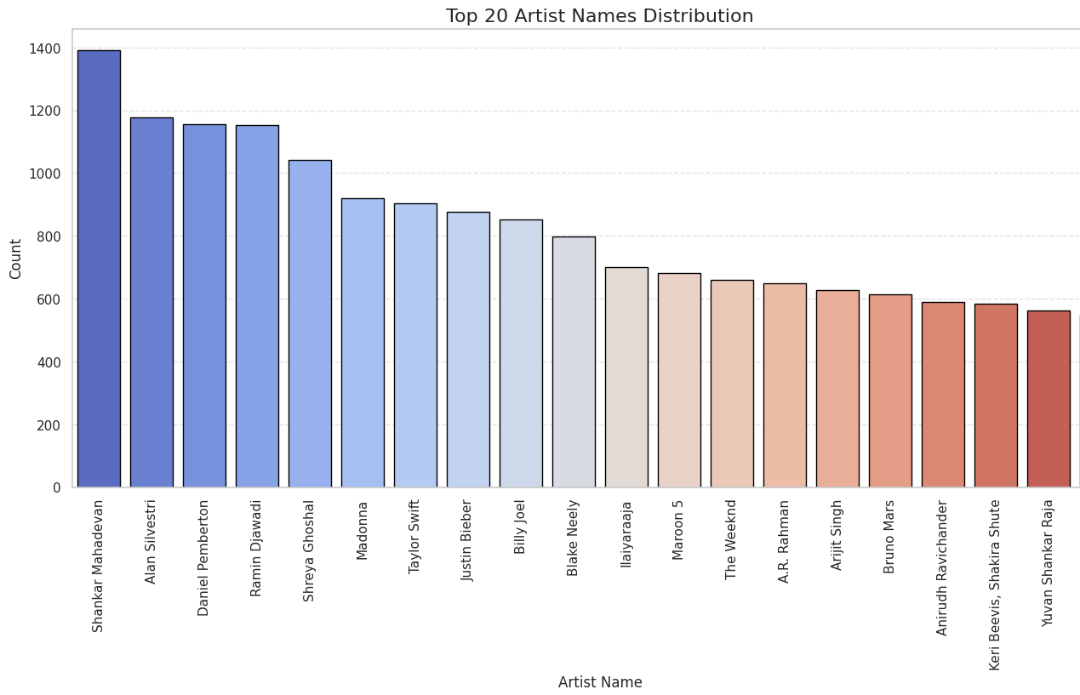
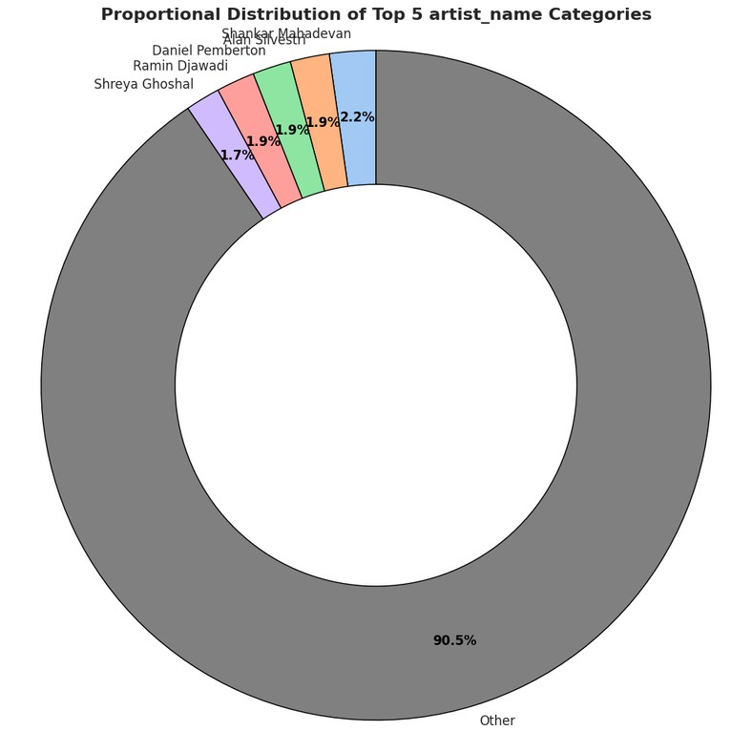
Meet The Top 20 Artists

Slide 17
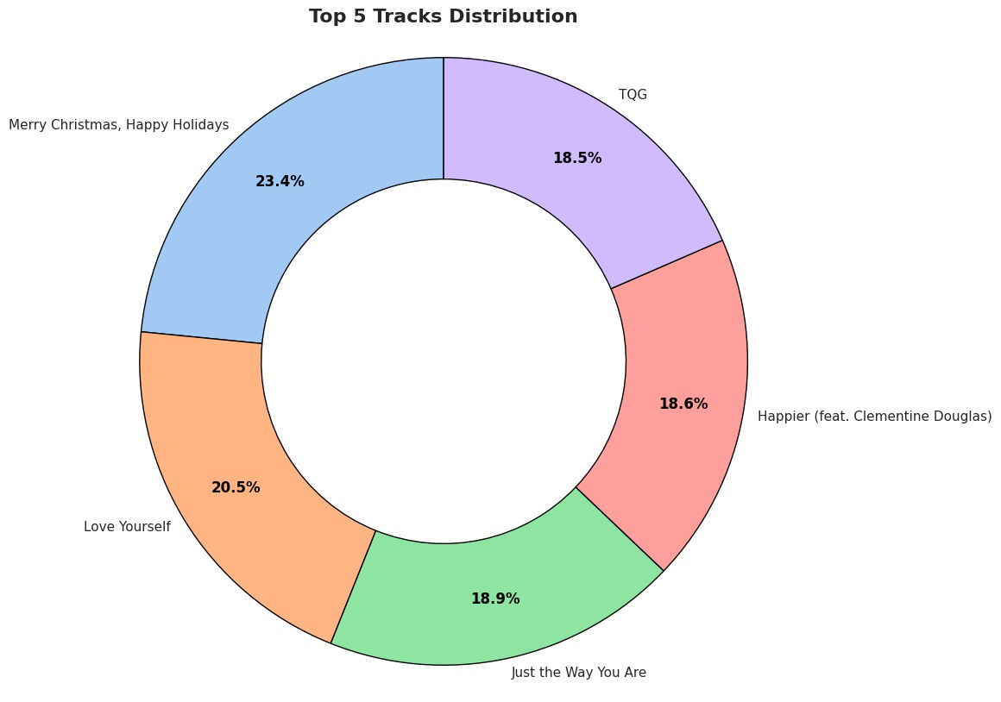
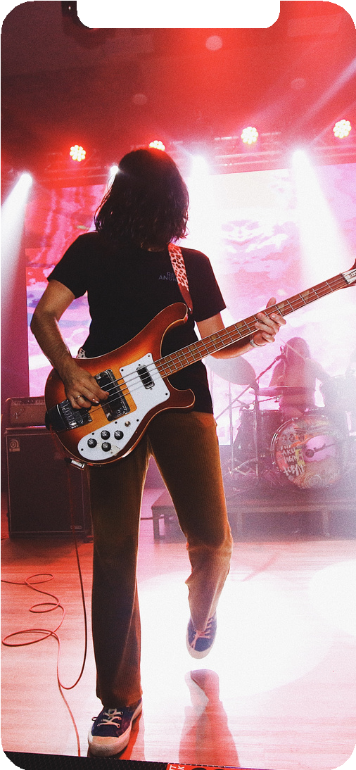


Know The Top 5 Tracks

Slide 18
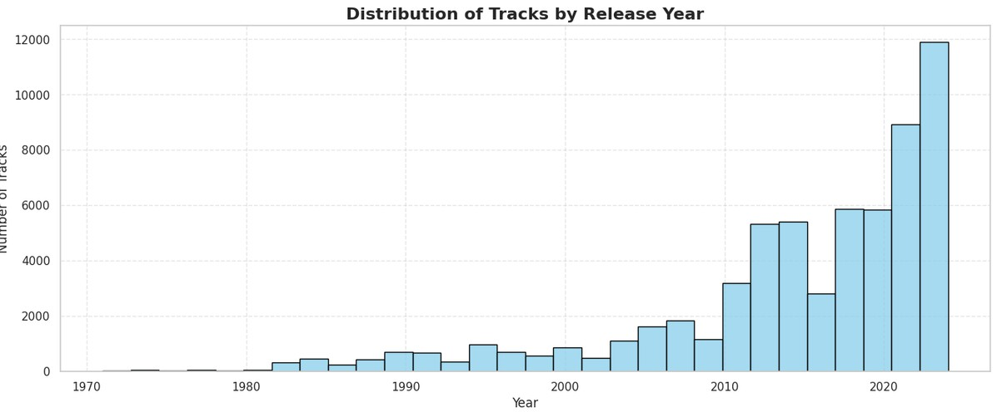
Distribution of Tracks by Release Year
This graph shows a dramatic exponential surge in track releases, with the volume remaining low and stable until the late 1990s.
Pre-2000: Minimal and steady output.
2000s: Gradual growth begins.
Post-2010: Explosive growth, culminating in the highest peak (over 12,000 tracks) in the final year shown.
Takeaway: Music production has been democratized and hyper-accelerated by digital platforms.

Slide 19
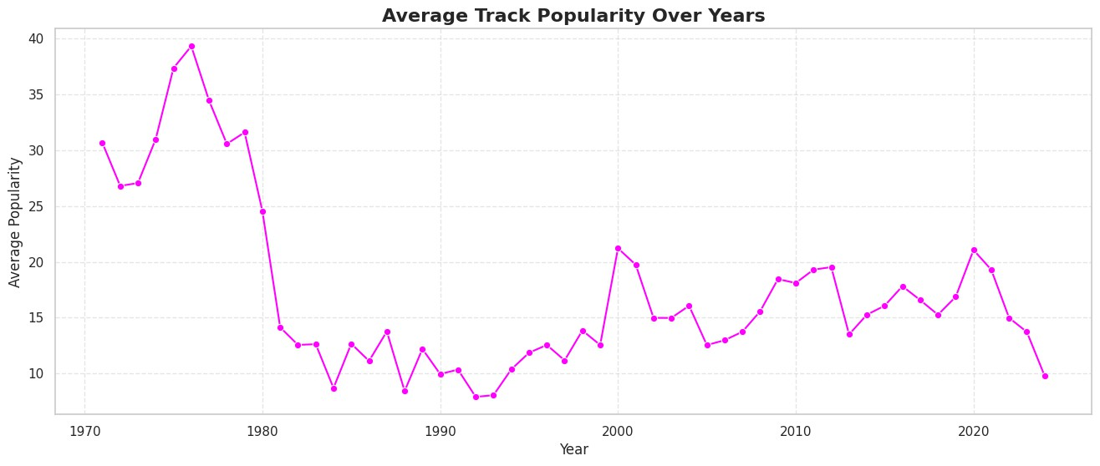
Average Track Popularity over years
The graph shows average track popularity has declined sharply from a high peak in the mid-1970s.
1970s: High popularity, peaking near 40.
Post-1980: Dramatic drop and sustained low popularity, generally below 20.
Modern Era: Stability at a much lower level, with a recent final year showing a low point.
Conclusion: The average track faces more competition and is significantly less popular now than in the 1970s.

Slide 20
Bivariate Analysis
01
02
03
ore

Slide 21
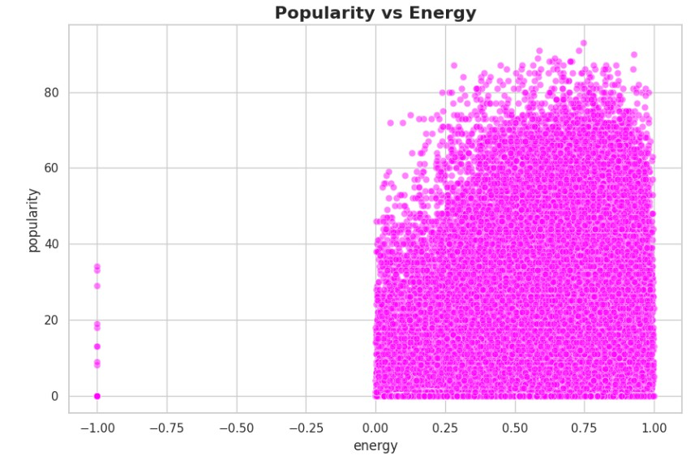
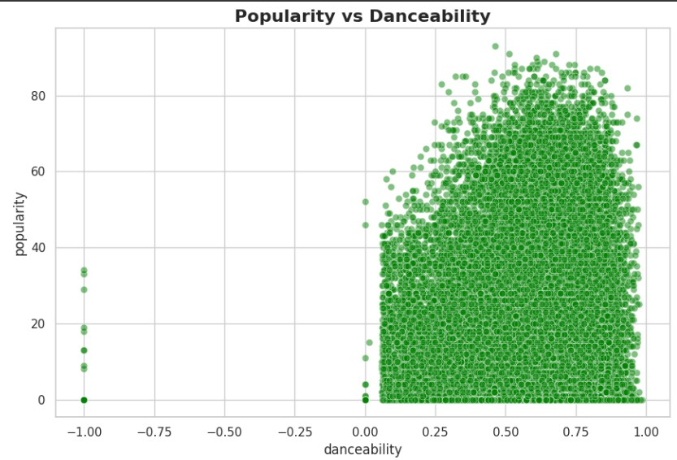
Popularity vs Energy
^{About}Popularity vs Danceability
01
02
03
Most high-energy tracks tend to have higher popularity.
Spread shows variability; some moderate- energy tracks are also popular.
Positive trend; tracks that are more danceable generally achieve higher popularity.
Outliers exist with very popular tracks having low danceability.

Slide 22
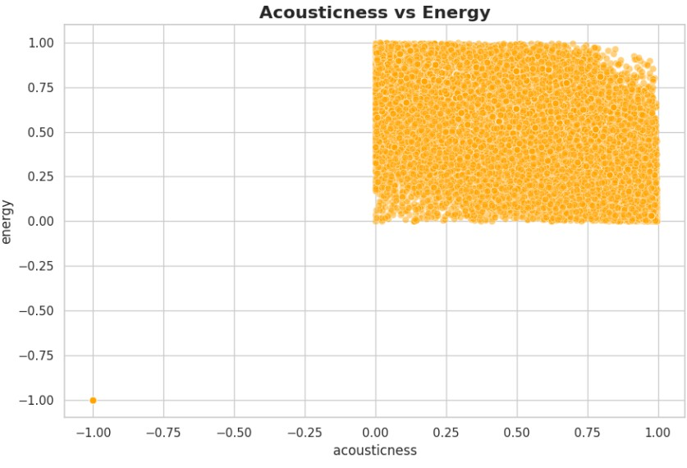
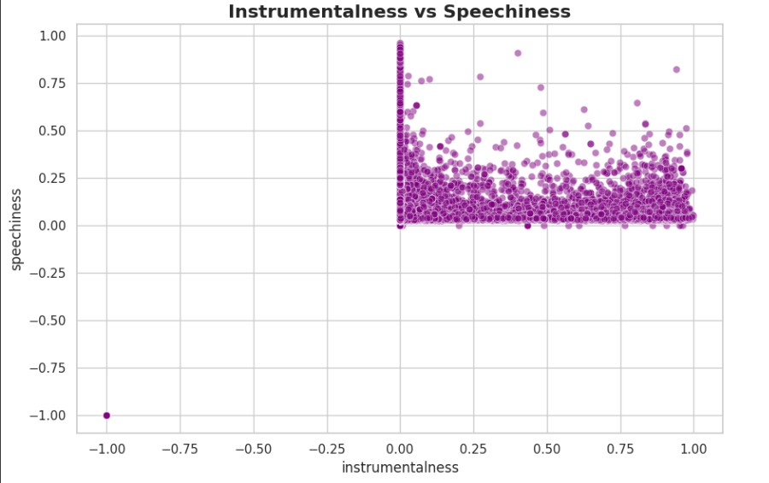
AboutInstrumentalness vs Speechiness
Acousticness vs Energy
Negative correlation; highly acoustic tracks tend to have lower energy.
Few acoustic tracks appear with high energy (outliers).
Strong negative correlation; instrumental tracks have low speechiness, as expected.
Tracks with vocals have high speechiness and low instrumentalness.

Slide 23
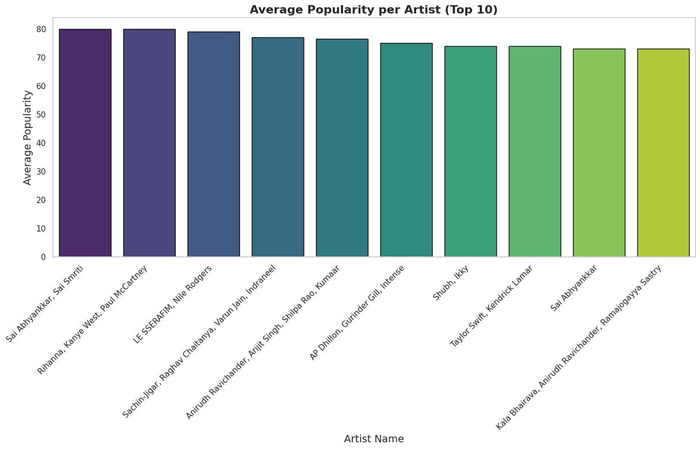
Average Popularity per Artist (Top 10)
High and Even Popularity: All top artists exhibit a very high and tightly clustered average popularity, with scores generally between 74 and 80.
The Top Tier: Sai Abhyankkar, Rihanna/Kanye West/Paul McCartney, and LE SSERAFIM/Nile Rodgers form the highest tier, all averaging near 80.
Key Insight: There is minimal differentiation among the top artists in terms of average popularity, suggesting that the very highest tier of music, regardless of genre or region, maintains a consistently high level of appeal.

Slide 24
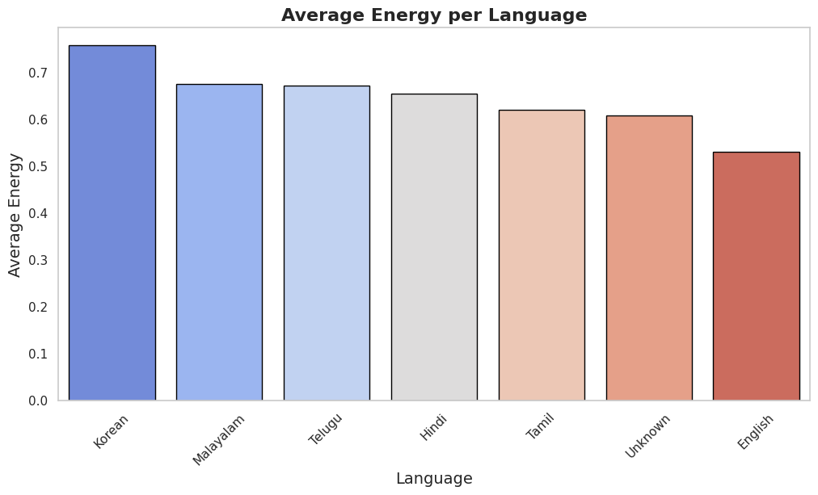
Average Popularity per Language
Korean Dominance: Korean music (K-Pop) has the highest average energy score (above 0.7), suggesting a predominantly high-tempo and active musical style in the dataset.
Clustered High Energy: Malayalam, Telugu, Hindi, and Tamil music are also clustered with relatively high average energy scores (around 0.62 to 0.68).
Lowest Energy: English music, followed by a category labeled "Unknown," has the lowest average energy score (around 0.53), indicating a broader inclusion of lower-tempo or more subdued tracks.
Overall: Non-English language tracks in this dataset tend to exhibit a higher average musical energy compared to their English counterparts.

Slide 25
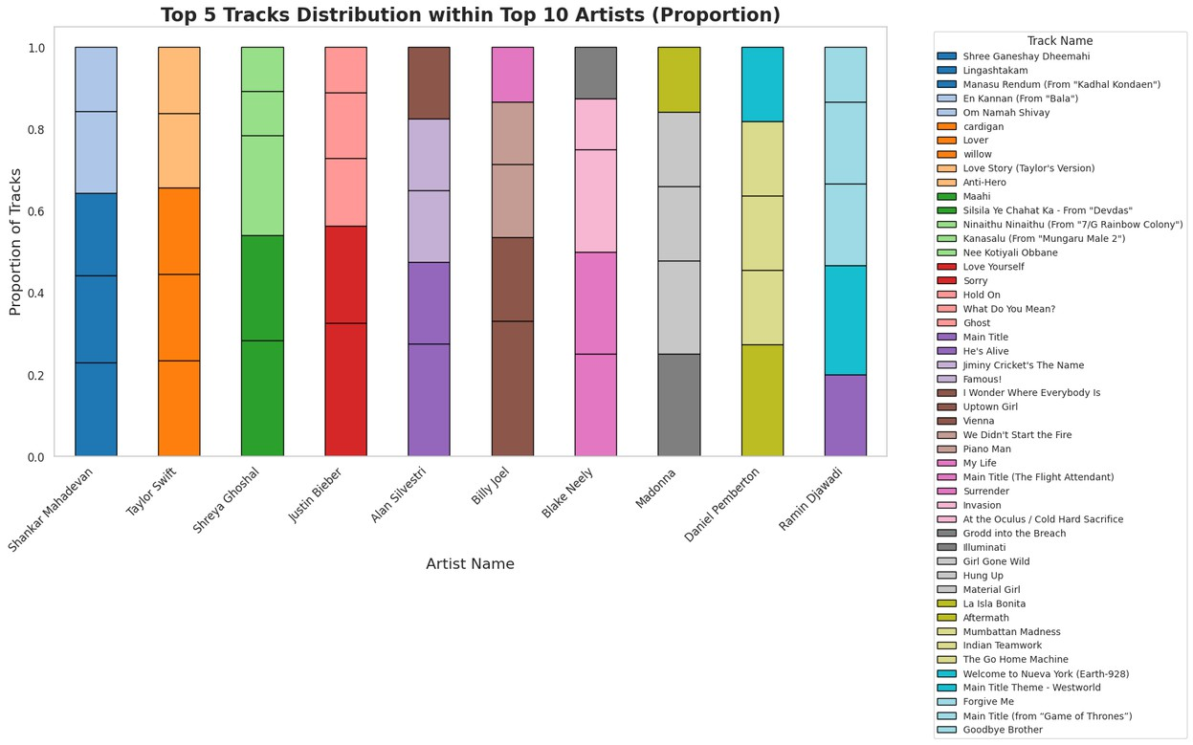
Distribution of the Top 5 Tracks as a proportion of total tracks for the Top 10 Artists
Track Concentration Varies: Some artists (e.g., Shreya Ghoshal, Justin Bieber, Billy Joel) show a very uneven distribution, with a few songs (large colored blocks) making up a high proportion of their total tracks in the dataset.
Track Diversity: Other artists (e.g., Shankar Mahadevan, Taylor Swift, Blake Neely) show a more even distribution across their top tracks (smaller, more equal-sized colored blocks), indicating a broader variety of popular songs driving their total track count.
Key Insight: The chart highlights which artists' popularity is heavily reliant on a few dominant tracks versus those whose popularity is driven by a larger catalog of well-performing songs.

Slide 26
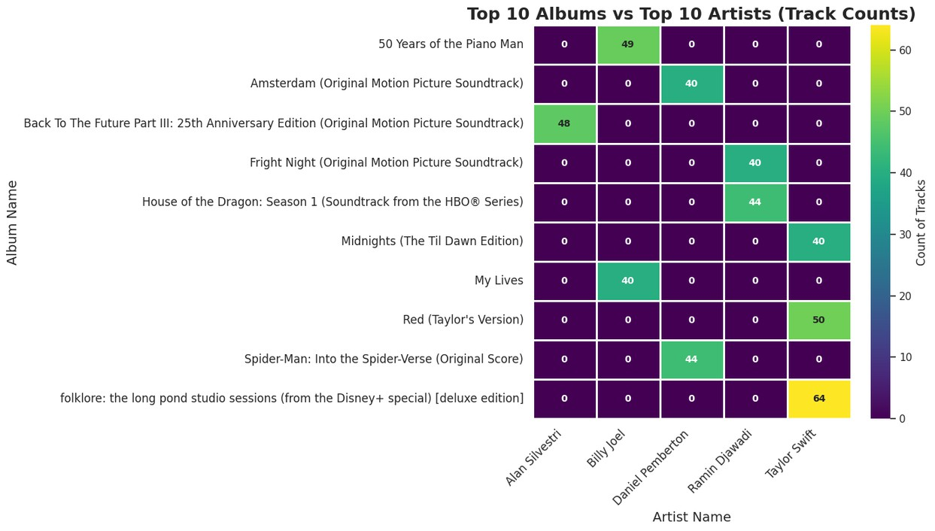
Top 10 Artists vs Top 10 Albums
Strong Artist-Album Dominance: The data shows clear, concentrated relationships.
Artists generally dominate a single album in this list, with most cells showing zero interaction.
Taylor Swift's High Concentration: Taylor Swift has the highest single concentration of tracks, with 64 tracks from the folklore: the long pond studio sessions (deluxe edition) and 50 tracks from Red (Taylor's Version).
Billy Joel's Catalog: Billy Joel's contribution is concentrated on the compilation album, 50 Years of the Piano Man, accounting for 49 tracks.
Soundtrack Specialists: Artists like Daniel Pemberton (Spider-Man: Into the Spider- Verse) and Ramin Djawadi (House of the Dragon) show clear specialization in their respective soundtracks, with 44 tracks each.
Key Takeaway: The top artists' track counts are not broadly distributed across many albums; instead, they are heavily concentrated in specific, successful, or comprehensive release packages (deluxe editions, compilations, or soundtracks).

Slide 27
Multivariate Analysis
01
02
03
ore

Slide 28
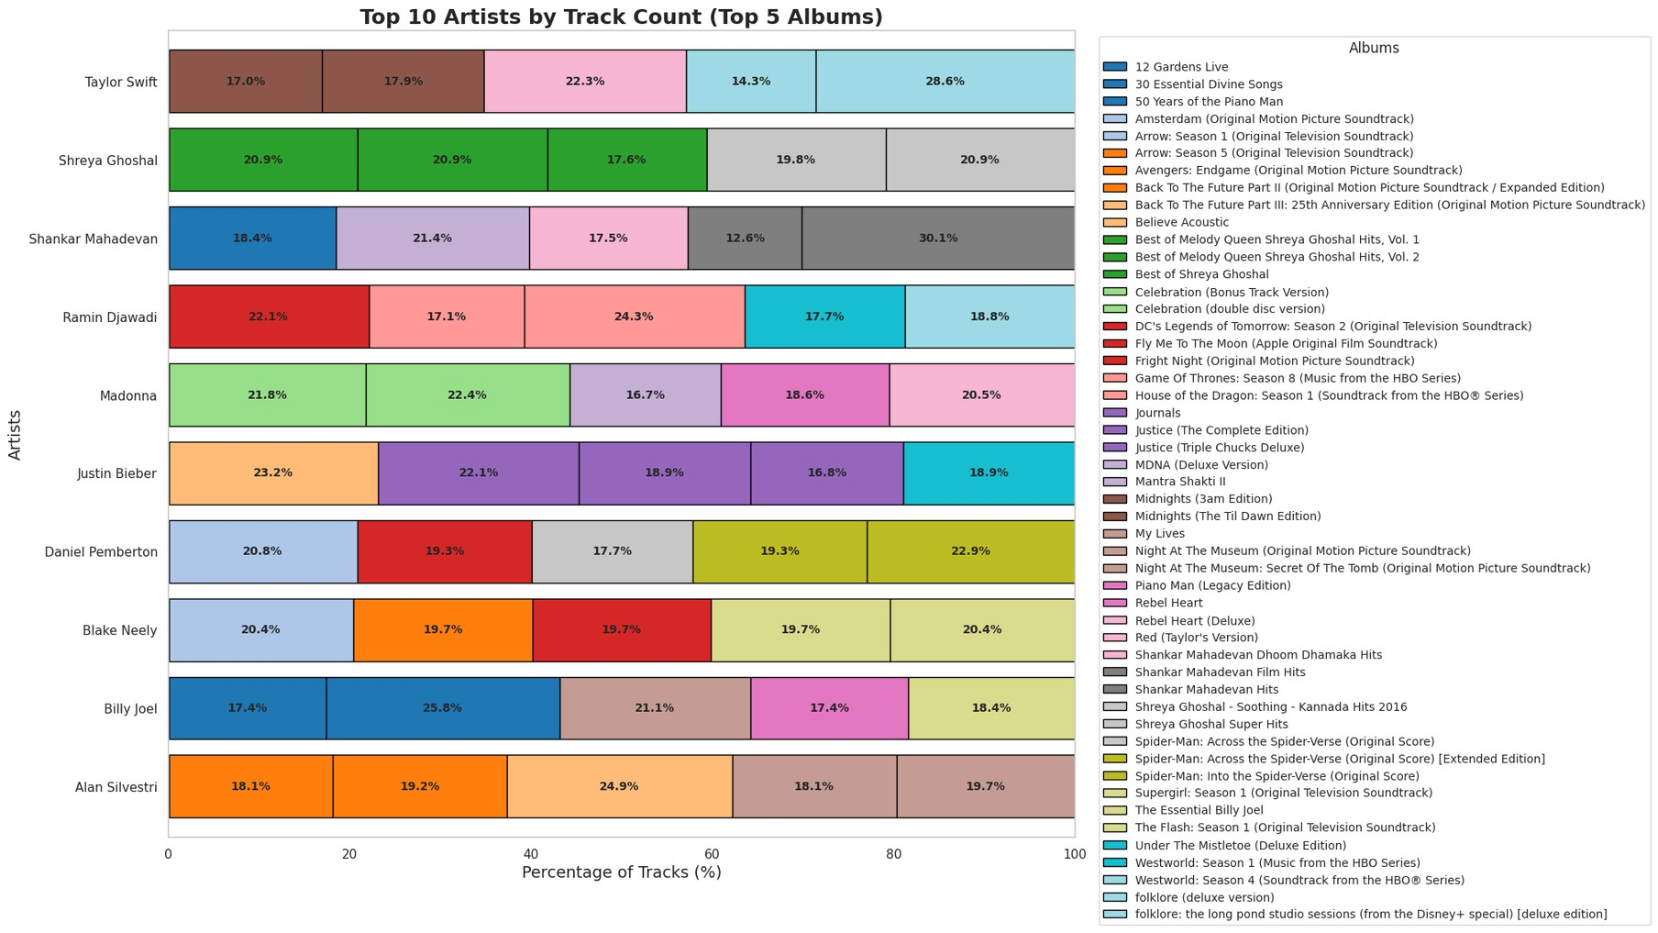
Top 10 artists by track count across their top 5 albums

Slide 29
Interpretation
Diversification: Artists like Taylor Swift and Shreya Ghoshal exhibit high diversification, with no single album dominating (all top 5 albums contribute between 17% and 30%). This indicates a pattern of releasing multiple substantial albums.
Concentration: Other artists show slight concentration, where one album accounts for a larger share of the total tracks from the top five. For instance, Alan Silvestri's and Billy Joel's largest individual albums contribute nearly 25% each.
Genre Influence: Soundtrack composers (e.g., Ramin Djawadi, Alan Silvestri) frequently top the list due to the nature of their work—scores often have high track counts across multiple seasons or extended editions, driving their overall total.
Top Album Variance: The contribution of the top individual album varies widely among artists, highlighting significant differences in the track quantity and packaging strategy (deluxe vs. standard) within the highest-ranking releases.

Slide 30
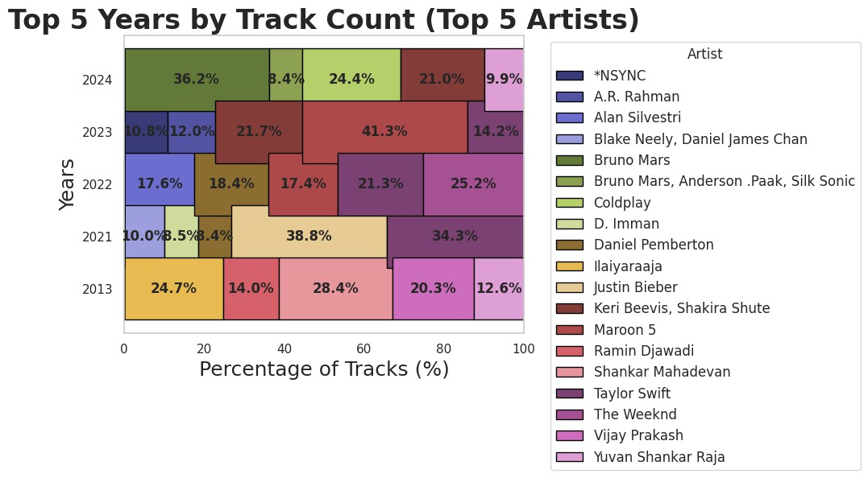
Top 5 years by track count for top 5 artists

Slide 31
Interpretation
Yearly Dominance: The chart reveals which artists drove the track count in each of the top five years. For example, 2021 was heavily dominated by Justin Bieber (38.8%) and The Weeknd (34.3%), accounting for over 73% of that year's total tracks from the featured artists.
Artist Concentration: 2023 shows the highest concentration, with Ramin Djawadi (41.3%) contributing over two-fifths of the tracks. 2024 is more diversified, led by Bruno Mars (36.2%) and Coldplay (24.4%).
Historical Context: 2013, the earliest year shown, features a strong split between Justin Bieber (24.7%), Ramin Djawadi (28.4%), and Vijay Prakash (20.3%).
Recurring Impact: Ramin Djawadi (Red) and Justin Bieber (Yellow/Tan) appear as major contributors in multiple years, suggesting consistent release of high-track-count albums across the examined period.

Slide 32
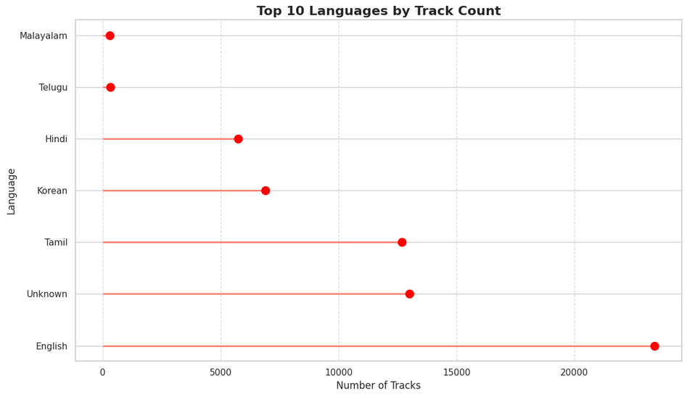
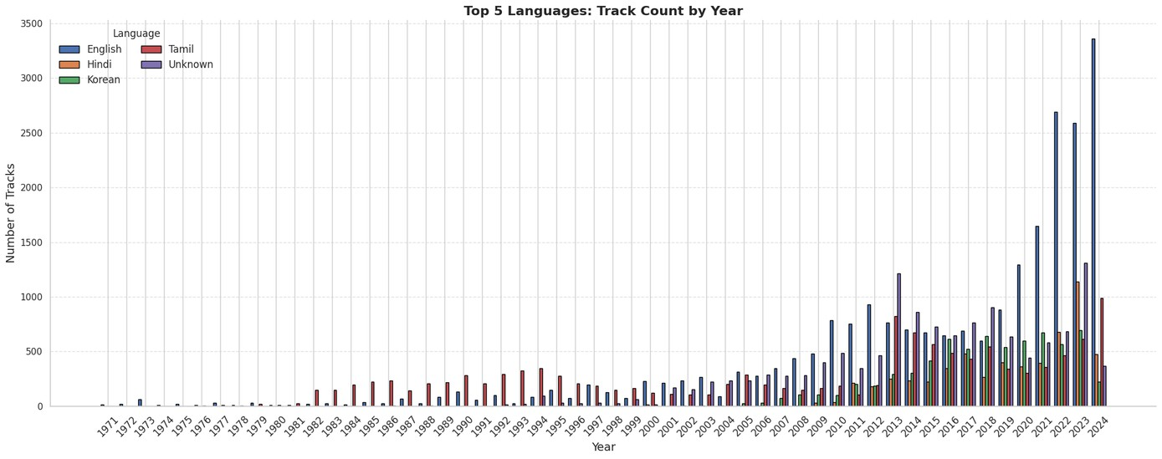
Top Languages by Track Count
The chart clearly indicates English is the dominant language by track count, vastly exceeding all others (over 22,500 tracks). Tamil and Unknown languages rank second and third, respectively, followed by Hindi and Korean. The remaining languages (Malayalam, Telugu, etc.) have significantly lower track counts, suggesting the dataset is heavily weighted toward English- language content, with a strong presence from South Indian languages and Korean.

Slide 33
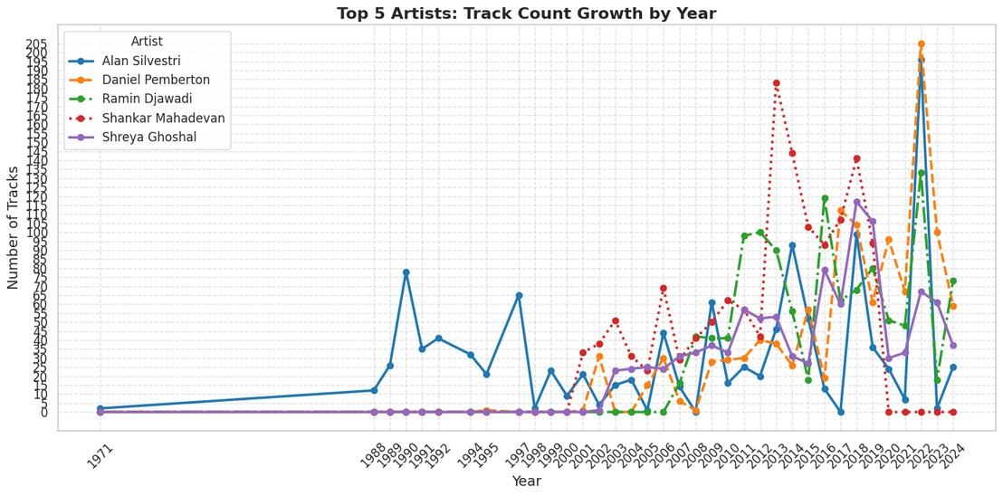

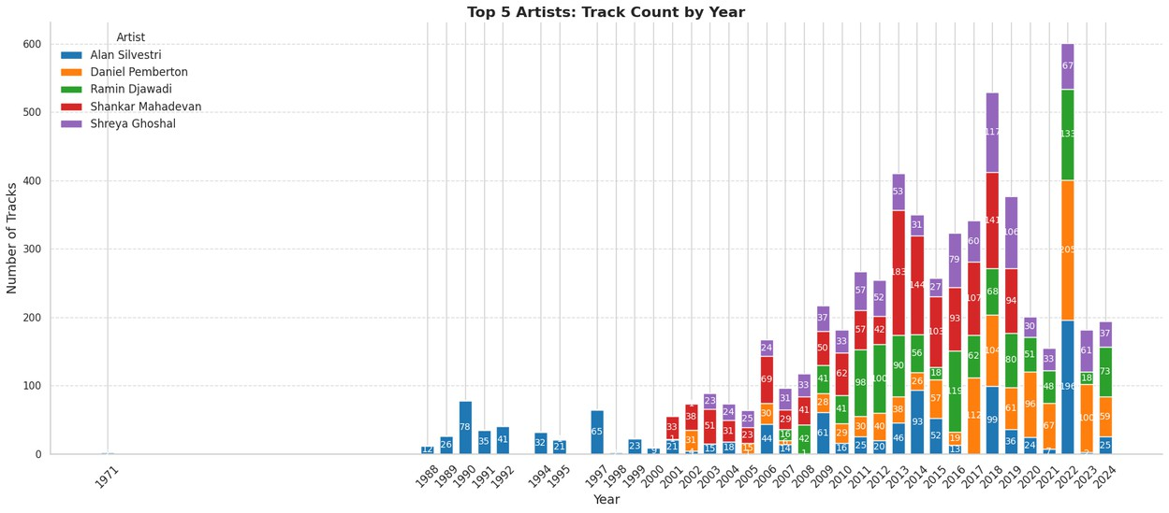

Top 5 Artists Track Count by Year

Slide 34
Interpretation
Volatility and Peaks: Track releases are highly volatile for most artists, marked by significant annual spikes followed by sharp drops.
Daniel Pemberton shows the most extreme peak, releasing over 200 tracks in 2023, far exceeding any other single-year count.
Shankar Mahadevan also exhibits high volatility, with notable peaks around 2014 and 2016-2017.
Composer Activity: Soundtrack composers like Alan Silvestri, Daniel Pemberton, and Ramin Djawadi show intermittent bursts of high activity, often corresponding to major film or TV releases.
Ramin Djawadi shows a sustained increase in high-track years from around 2010 to 2017.
Shreya Ghoshal's Consistency: Shreya Ghoshal displays the most relatively consistent track output in the later years (post-2010), maintaining a steady, moderate level of releases compared to the dramatic spikes seen by others.
Early Career: Alan Silvestri has the longest recorded history, showing intermittent track counts dating back to 1988-1990, while Shreya Ghoshal's output begins later, showing consistent low-level activity from the early 2000s.

Slide 35
Time Series Analysis
01
02
03
ore

Slide 36
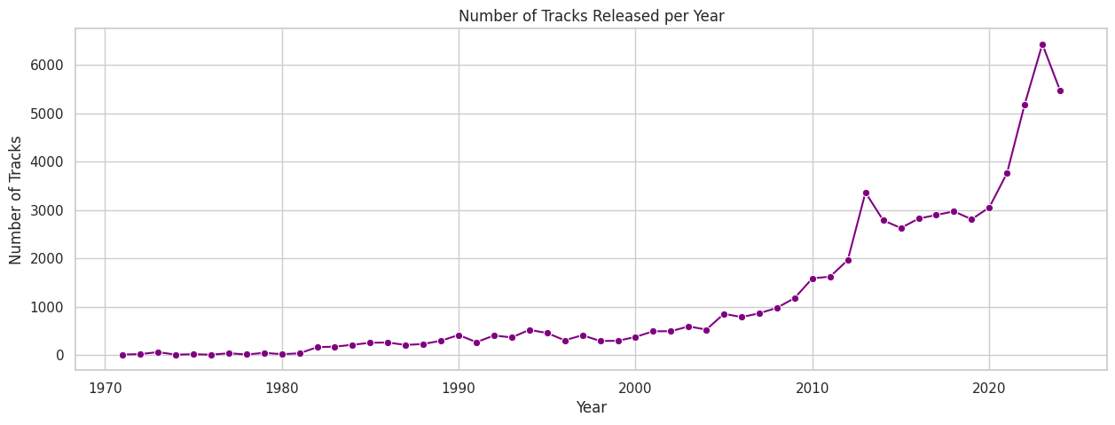
Total Number of Tracks Released per Year
The data shows a trajectory of explosive growth in the number of tracks released. Track counts remained relatively flat and low (under 1,000) from the 1970s until around 2007. A sharp increase began around 2010, and while there were minor fluctuations, the number of tracks released annually surged dramatically, peaking at over 6,000 tracks in the most recent years (around 2023). This highlights a significant and recent escalation in overall track production or recording/cataloging activity within the dataset.

Slide 37
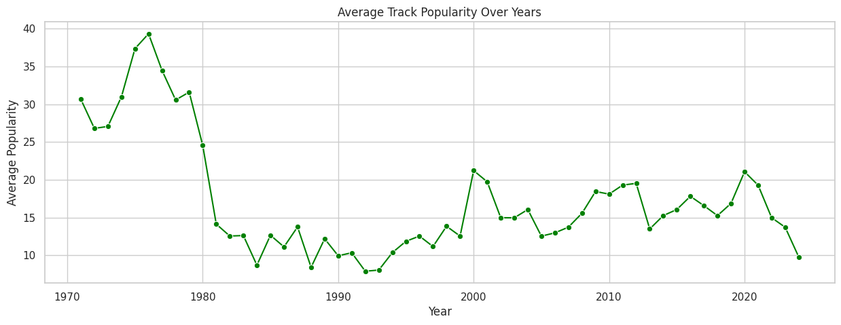
Average Track Popularity over the years
The chart shows extreme volatility in average track popularity. It peaked around 1978 (near 40) before undergoing a dramatic sharp decline in the early 1980s. Popularity then remained low and stable (mostly 8–15) until the late 1990s. From 2000 onward, there's been a moderate, fluctuating recovery (mostly 15–20), with a noticeable recent decline after a small peak around 2020. Overall, the average popularity of tracks in the dataset is significantly lower in the modern era than in the late 1970s.

Slide 38
Outlier Analysis
01
02
03
ore

Slide 39
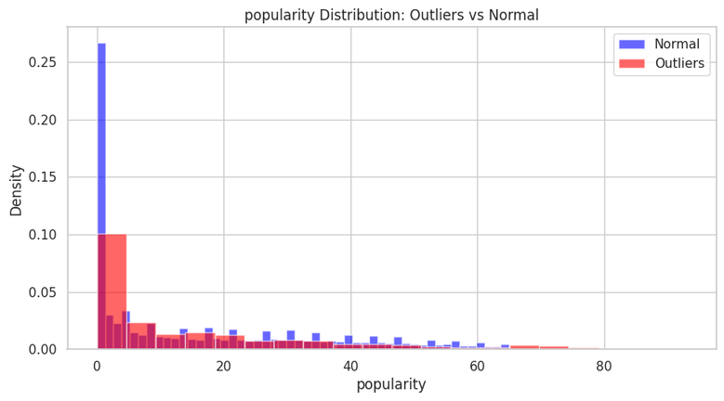
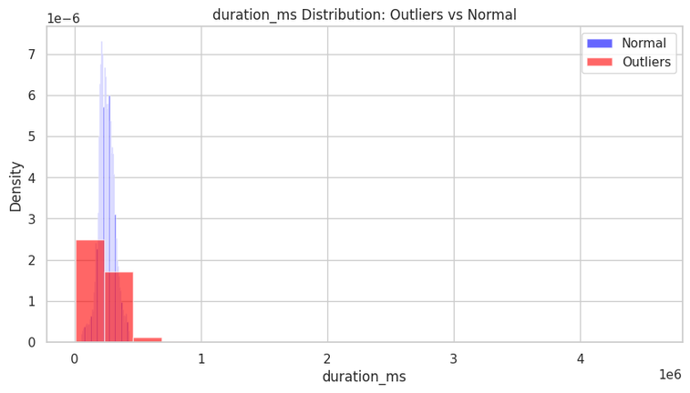
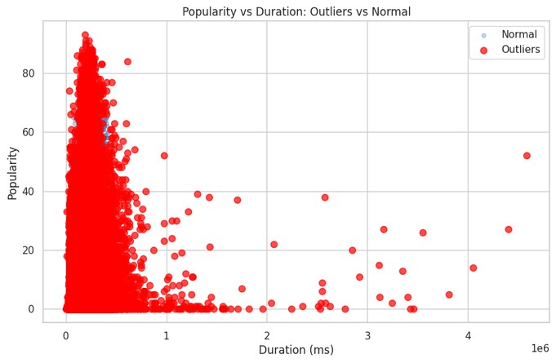
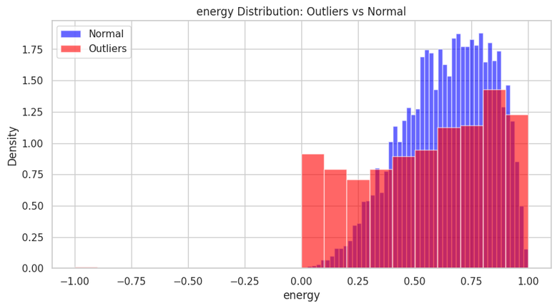
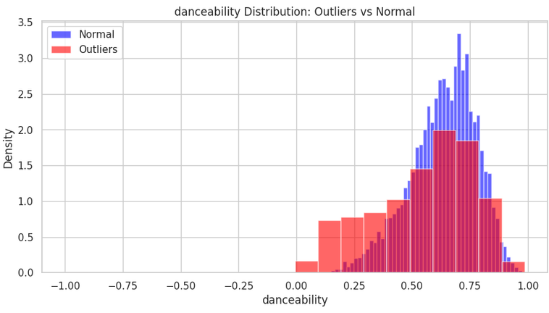

Slide 40
Interpretation
The Outlier classification effectively isolates tracks that significantly deviate from this popular but undistinguished core in three key dimensions: Commercial Extremes (Popularity): Tracks with uncaracteristically high popularity (scores up to ≈90) are classified as outliers, regardless of their
length or feature scores.
Structural Extremes (Duration): Tracks with uncaracteristically long durations (up to 75+ minutes) are classified as outliers, representing a clear structural deviation from the norm.
Feature Extremes (Energy/Mood): Tracks with uncaracteristically low danceability or low energy scores are flagged as outliers, suggesting the model isolates songs that are exceptionally subdued or difficult to dance to, departing from the dataset's high-energy standard.

Slide 41
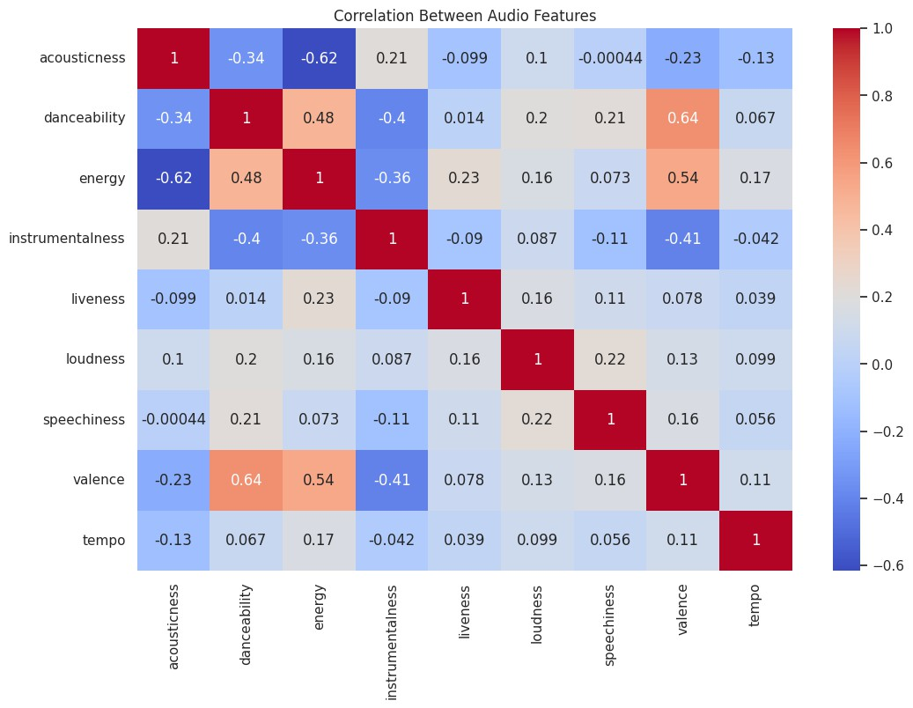

Slide 42
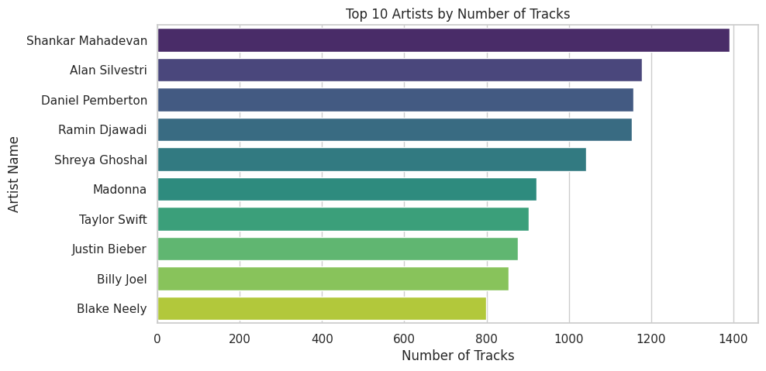
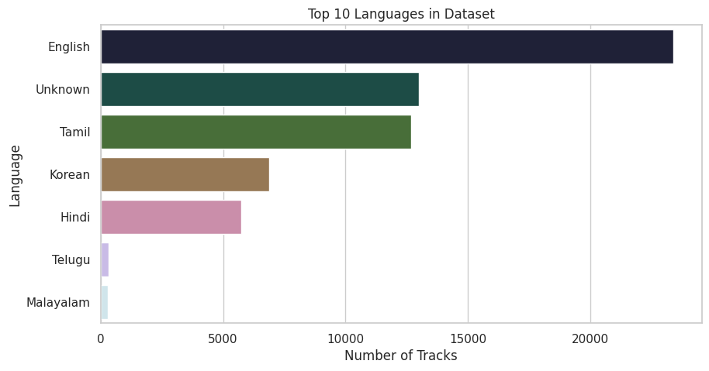
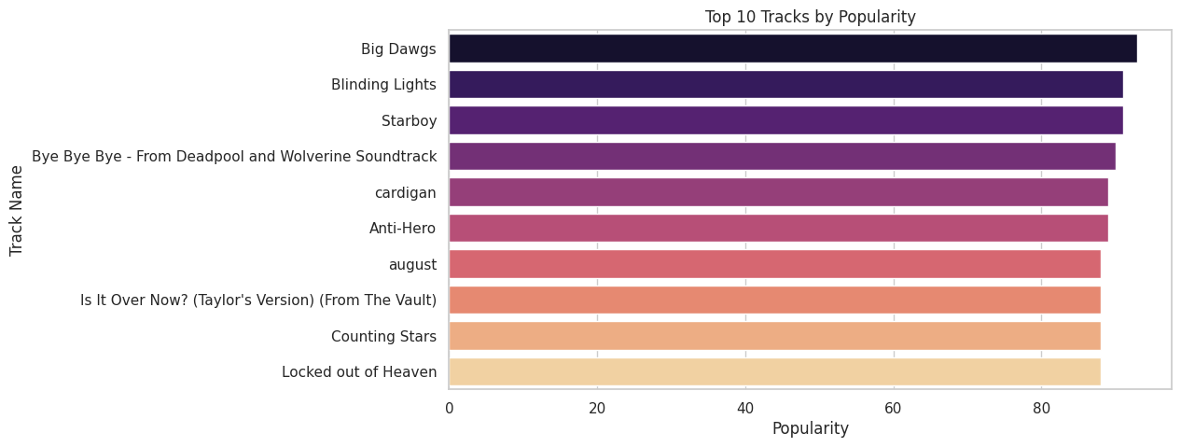
Presenting The Top 10

Slide 43

Strategic Playbook: Data- Driven Music Production

Slide 44
Pillar 1: The Sonic Sweet Spot (Maximizing Engagement)
Recommendation
Focus on an "Energetic & Danceable" Profile. Engineer tracks to maximize both features, aligning your sound with the statistical profile of commercial success.
Insight
Popular tracks consistently exhibit high Danceability (>0.7) and Energy (>0.8).

Slide 45
Pillar 2: The Modern Mix (Efficiency & Impact)
Recommendation
Master for a Modern, Impactful Mix. Target a competitively loud mix. Use a shorter, efficient song structure to boost listener engagement and streaming completion rates.
Insight
Average loudness has steadily increased while track duration has decreased. Modern music is louder and more concise.

Slide 46
Pillar 3: Global Reach (Market Expansion)
Recommendation
Leverage Shifting Language Trends. Explore collaborations with artists in these ascending markets or develop multilingual versions of key tracks.
Insight
Non-English languages, particularly Spanish and Korean, show a significant, rapid increase in popularity over the last decade.

Slide 47
Pillar 4: Niche Clarity (Feature Specialization)
Recommendation
Target a Clear Niche: Lyrical vs. Instrumental. For instrumental tracks, focus production efforts on maximizing secondary features like Energy and Valence to drive popularity within that segment.
Insight
Speechiness is highly bimodal (tracks are either highly lyrical or purely instrumental).

Slide 48


Thank You
01
02
F o r W a t c h i n g t h i s P r e s e n t a t i o n
03
~ By Rohan kumar

